Slide 1

<p>,<a>, <img>,<ol> vs
Team-3

Slide 2
Paragraph tag<p>
1
The <p> tag in HTML defines a paragraph. These have both opening and closing tags. So anything mentioned within <p> and </p> is treated as a paragraph.
Align attribute: The <p> tag specifically supports the alignment attribute and allows us to align our paragraphs in left, right, or center alignment.
2

Slide 3
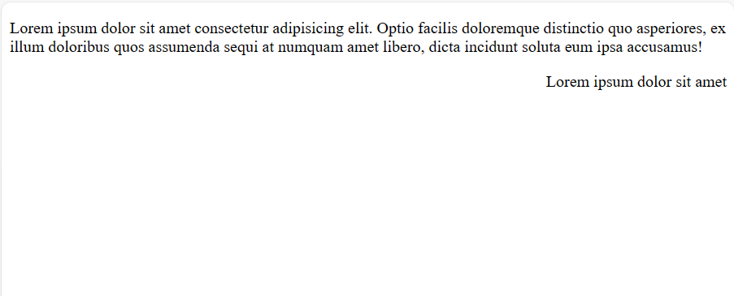
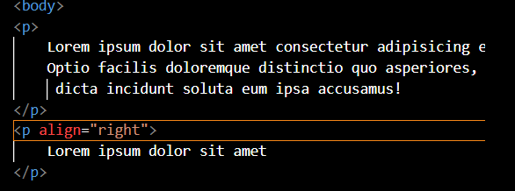

Slide 4
Links <a>
1
The Html element <a href=“value”>link text </a> Is an inline element that defines a hyperlink
Attribute
href “<a href=“value”>link text </a>”
Target <a target=“value”></a>
_self default: Opens the document in the same window/tab as it was clicked
_blank: opens the document in a new window or tab
_parent: Opens the document in the parent frame
2

Slide 5
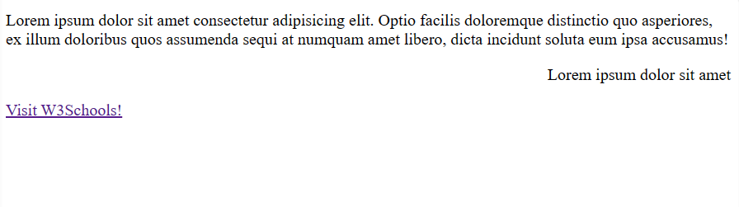
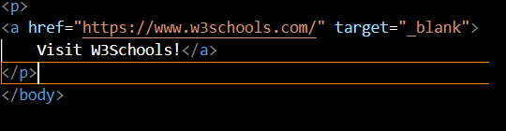


Slide 6
Tag: <img src=“” alt =“” ></img> Inline element attribute in img 1- src: source 2- alt: alternate text values for src: URL, Path from device,
1
Images <img>
2
4
3

Slide 7
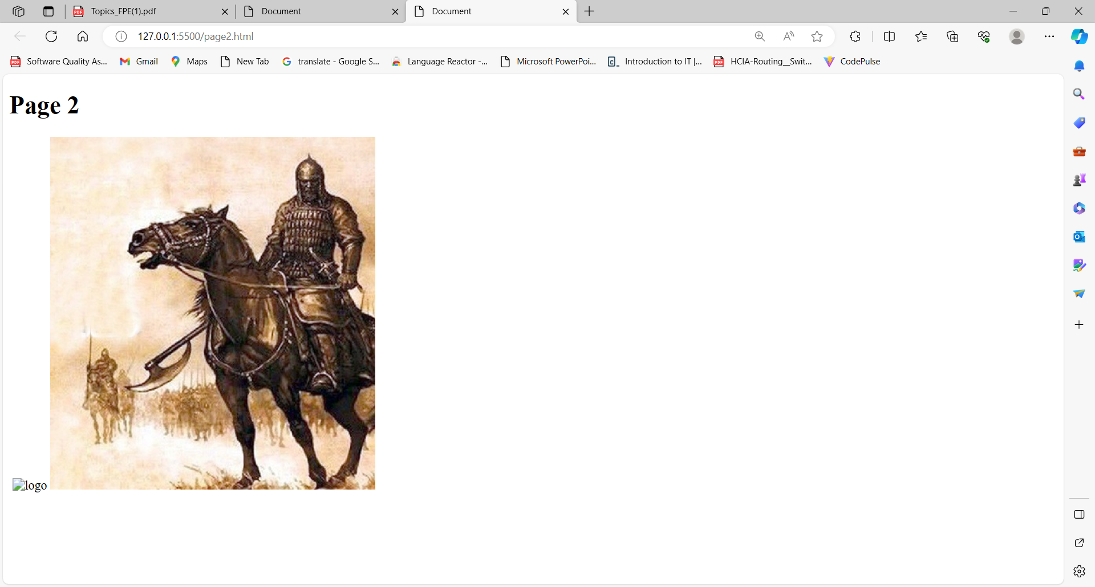
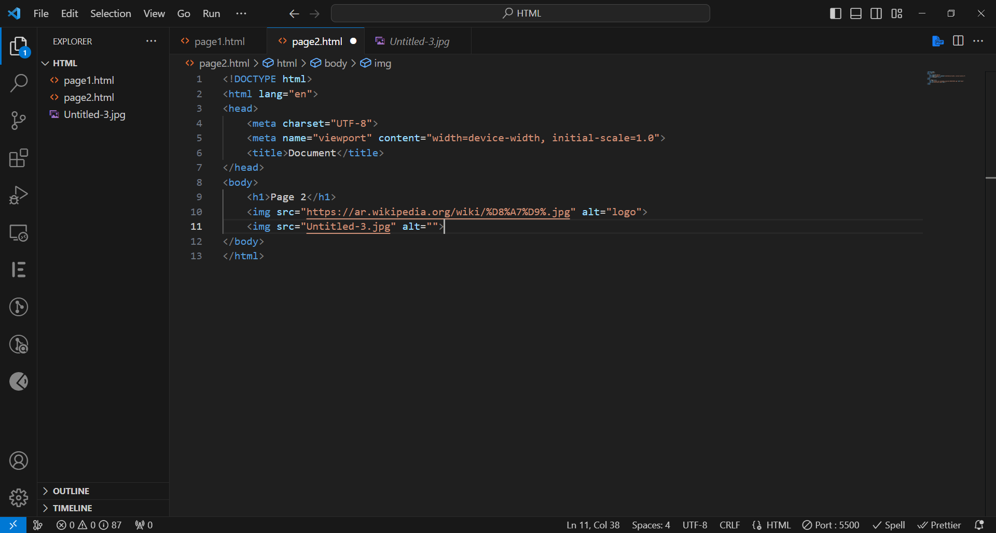

Slide 8
List <ul>,<ol> <dl>
1
An unorder list stars with <ul> tag. Each item starts with the <il> tag
An order list starts with the <ol> tag. Each item stars with the <il> tag
A description list is a list of terms, with a description of each term, the <dd> tag define it and <dt> tag defines the term
2
3

Slide 9
